Slide 1

Grocery Store Management

Slide 2
Objective of the Project
To design and implement a relational database for a grocery store.
To retrieve and manipulate data using SQL queries.
To perform data analysis for business insights such as top customers, best-selling products, and revenue trends.
To practice using joins, aggregations, subqueries, and filtering techniques.

Slide 3
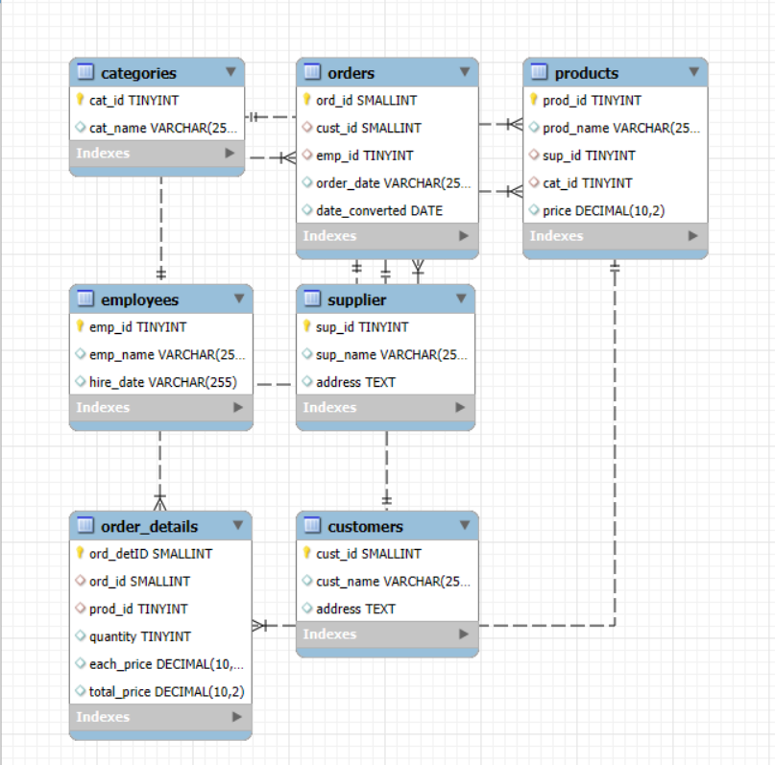
ER Diagram and schema explanation
Table Structure
1. Supplier Table
2. Categories Table
3. Employees Table
4. Customers Table
5. Product Table
6. Orders Table
7. Order Details Table

Slide 4
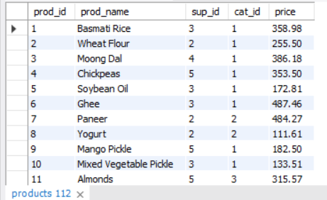
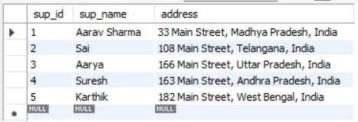
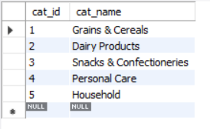
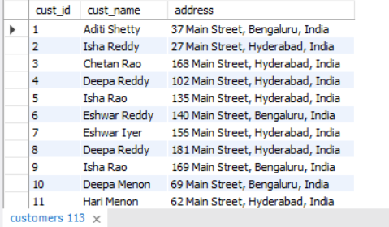
List of Tables Used
Suppliers Table Products Table
Categories Table Customers Table

Slide 5
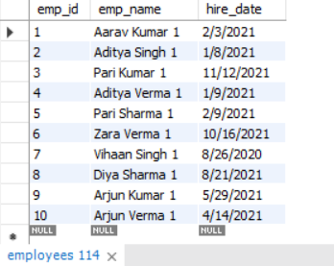
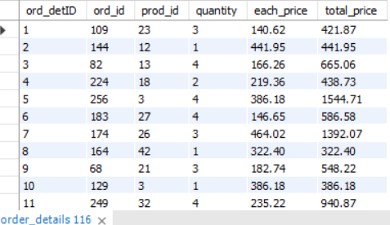
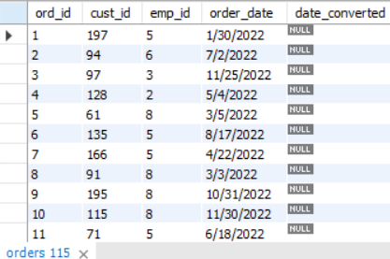
List of Tables Used
Employees Table Order Details Table
Orders Table

Slide 6
Problem Statement
This project is about building a grocery store database to keep track of products, customers, suppliers, and orders. It helps monitor stock, sales, and customer activities. SQL is used to get useful business insights from the data.
The goal is to make store operations smoother and help managers make better decisions.

Slide 7


Customer Insights
How many unique customers have placed orders?
Query
Output

Slide 8
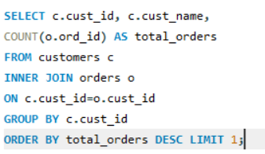

Which customers have placed the highest number of orders?
Query
Output

Slide 9
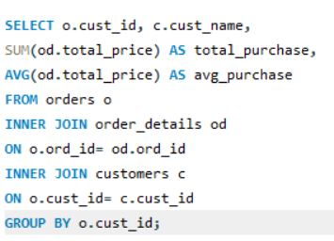
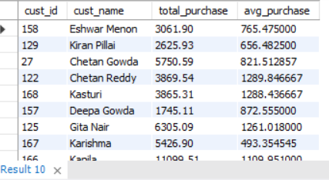
What is the total and average purchase value per customer?
Query
Output

Slide 10
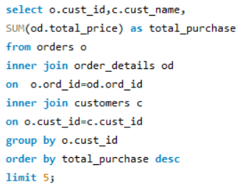
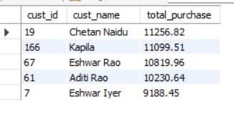
Who are the top 5 customers by total purchase amount?
Query
Output

Slide 11
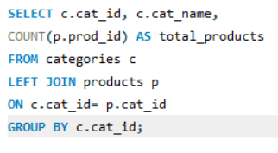
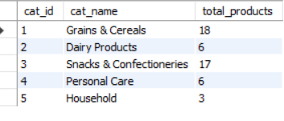
Product Performance
How many products exist in each category?
Query
Output

Slide 12
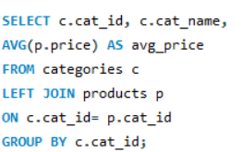
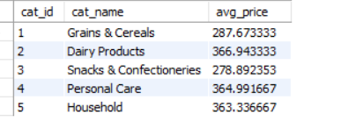
What is the average price of products by category?
Query
Output

Slide 13
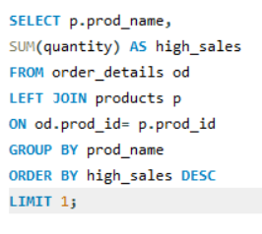

Which products have the highest total sales volume (by quantity)?
Query
Output

Slide 14
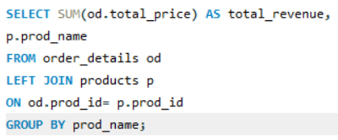
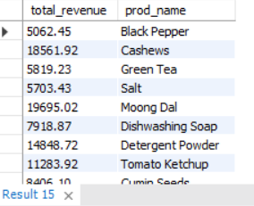
What is the total revenue generated by each product?
Query
Output

Slide 15
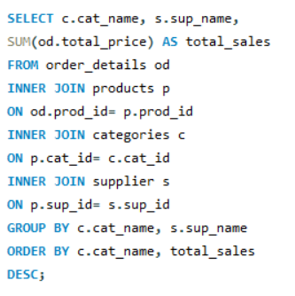
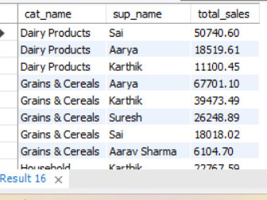
How do product sales vary by category and supplier?
Query
Output

Slide 16


Sales and Order Trends
How many orders have been placed in total?
Query
Output

Slide 17


What is the average value per order?
Query
Output

Slide 18
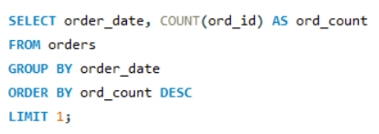

On which dates were the most orders placed?
Query
Output

Slide 19
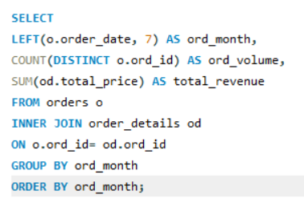
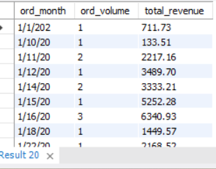
What are the monthly trends in order volume and revenue?
Query
Output

Slide 20
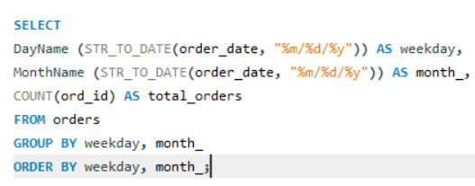
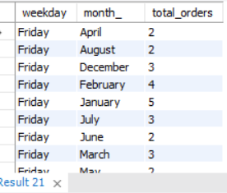
How do order patterns vary across weekdays and weekends?
Query
Output

Slide 21


Supplier Contribution
How many suppliers are there in the database?
Query
Output

Slide 22
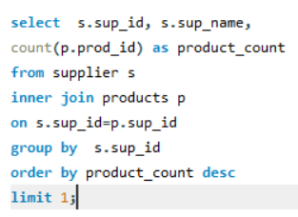

Which supplier provides the most products?
Query
Output

Slide 23
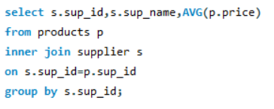
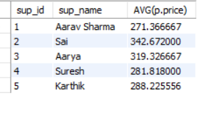
What is the average price of products from each supplier?
Query
Output

Slide 24
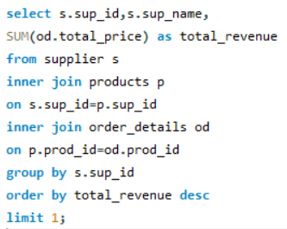

Which suppliers contribute the most to total product sales (by revenue)?
Query
Output

Slide 25


Employee Performance
How many employees have processed orders?
Query
Output

Slide 26
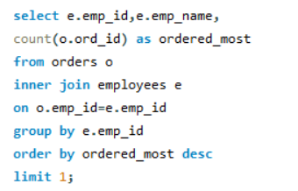

Which employees have handled the most orders?
Query
Output

Slide 27
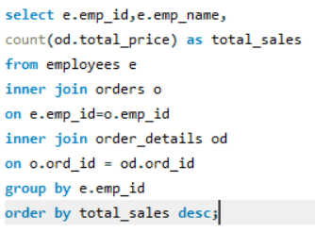
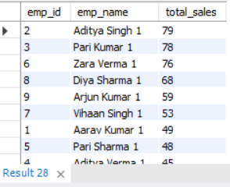
What is the total sales value processed by each employee?
Query
Output

Slide 28
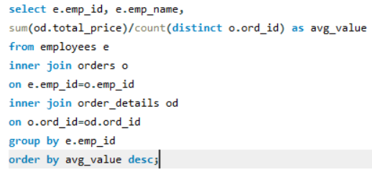
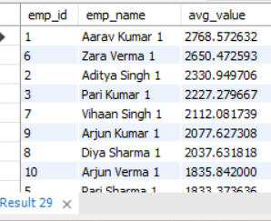
What is the average order value handled per employee?
Query
Output

Slide 29
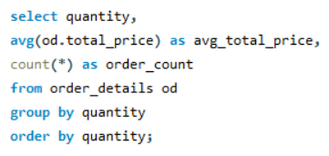
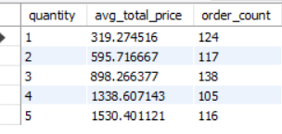
Order Details Deep Dive
What is the relationship between quantity ordered and total price?
Query
Output

Slide 30
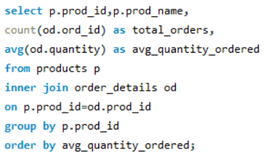
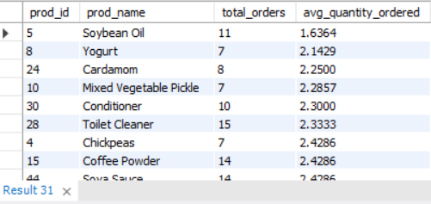
What is the average quantity ordered per product?
Query
Output

Slide 31
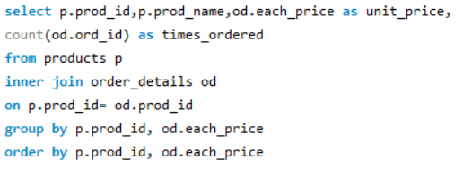
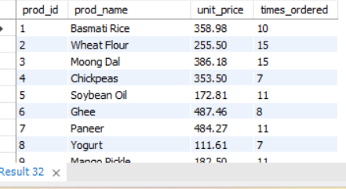
How does the unit price vary across products and orders?
Query
Output

Slide 32
Challenges We Faced
So, working on this data analysis project was a great learning Experience. It was very satisfying to see how raw data is transformed in to useful insights for a business.
Understanding table relationships and applying correct Joins
Handling Aggregation across joined tables.
Managing complex relationships between tables (e.g., customers, products, suppliers, orders)
Writing advanced SQL queries for meaningful analysis

Slide 33
Conclusion
The grocery store database project successfully demonstrates how structured data management can improve store operations. By using SQL to analyze and extract insights from the data, the system helps in tracking inventory, understanding customer behavior, and streamlining order management. Overall, this project highlights the importance of database systems in making informed business decisions and enhancing operational efficiency in a retail environment.

Slide 34

THANK YOU

